Slide 1
Algebra 4
Day 76

Slide 2

Bell Work
Solve:
$${1.) 3log}_{2}{(3x+1)=21}$$
$${2.) 3}^{2x−4}−48=8$$

Slide 3
From Last Time
Page 473 #1–5, 7–23 (odd)

Slide 4
7.5 Exponential and Log Equations
Objective:
Solve exponential and log equations

Slide 5
Strategies to Solve:
1.) One to One: rewrite so the bases are the same and compare
2.) Rewrite exponential in log form and apply the Inverse Property
3.) Rewrite log in exponential form and apply the Inverse Property

Slide 6

Examples: Solve
${1.) 3}^{x}=81$
2.) ln x–ln 2 = 0
${3.) 2}^{x}=8$
${4.) log}_{6}{2x=4}$

Slide 7
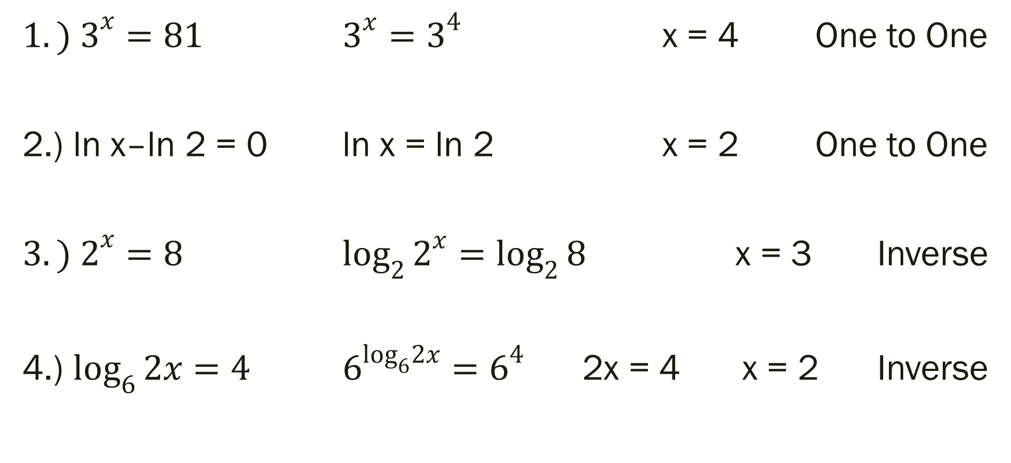
Examples
${1.) 3}^{x}=81$ $3^{x}=3^{4}$ x = 4 One to One
2.) ln x–ln 2 = 0 ln x = ln 2 x = 2 One to One
${3.) 2}^{x}=8$ $\log_{2}{2^{x}=\log_{2}{8}}$ x = 3 Inverse
4.) $\log_{6}{2x=4}$ $6^{\log_{6}2x}=6^{4}$ 2x = 4 x = 2 Inverse

Slide 8

Additional Examples
1.) ${8(2)}^{x}−10=70$ 5.) $3^{5x}=3^{3x−8}$
${2.) 5(3)}^{6x−12}+12=32$ ${6.) log}_{7}{(4x−7)=\log_{7}{(x+8)}}$
${3.) 4e}^{x+1}=12$ 7.) ln (6x – 1) = 3
${4.) 4log}_{2}\left(2x+9\right)−21=3$

Slide 9
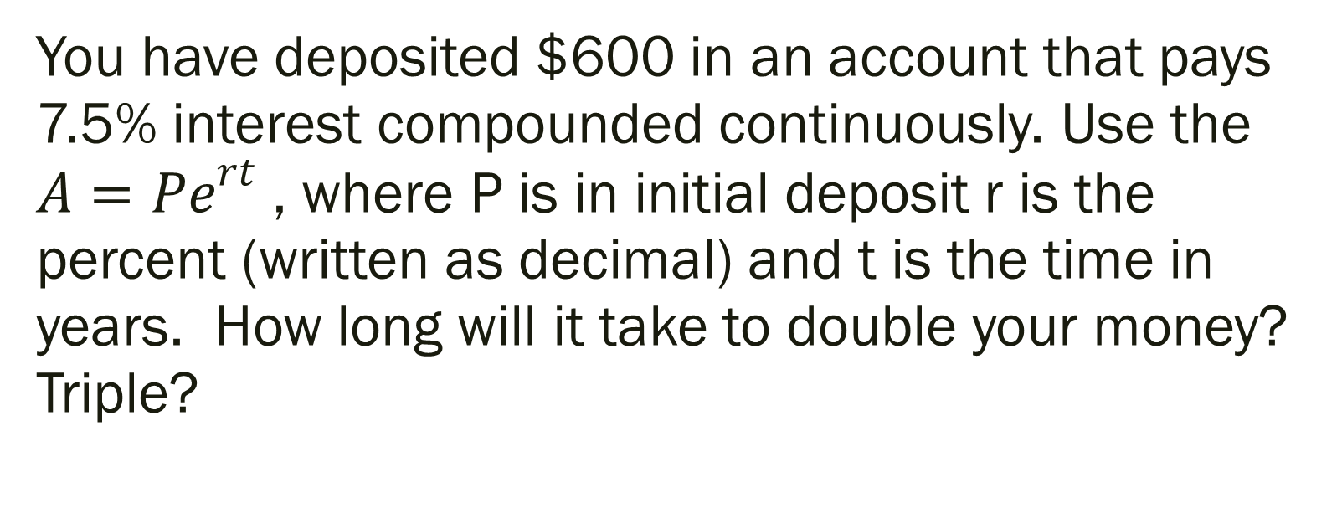
Answer the following.
You have deposited $600 in an account that pays 7.5% interest compounded continuously. Use the ${A=Pe}^{rt}$ , where P is in initial deposit r is the percent (written as decimal) and t is the time in years. How long will it take to double your money? Triple?

Slide 10

Set Up Solution
${A=Pe}^{rt}$ → ${1800=600e}^{0.075t}$ → ${3=e}^{0.075t}$ → t = ???
P = 600
r = 0.075
A = 1800 (tripled the P)
t = time

Slide 11
For Next Time…
Page 473 #10-14 (even), 18, 31–41 (odd), 49

